Slide 1
Spatial Indexing System Using QuadTree

Slide 2
Group Members:
Saba Batool(FA24B1-CS-018)
Minahil Khan(FA24B1-CS-067)
Manahil Hareem(FA24B1-CS-055)
Yusra Rana(FA24B1-CS-000)

Slide 3
Introduction
Modern applications like Google Maps, Uber, and Facebook need fast location searching
Handling thousands of locations efficiently is difficult with simple arrays
Spatial Indexing helps organize data based on coordinates
QuadTree is a powerful data structure for this purpose

Slide 4
What is Spacial Indexing?
Technique to store and search data using geographical coordinates
Data is organized based on location instead of sequence
Used in:
Maps
Ride-sharing apps
Emergency systems
Social media nearby features

Slide 5
Why QuadTree?
Divides 2D space into four equal regions
Reduces search time significantly
Efficient for:
Range queries
Nearest neighbor search
Large spatial datasets

Slide 6
What is QuadTree?
A tree-based data structure
Each node represents a rectangular area
Each node can have 4 children:
North-East
North-West
South-East
South-West
Used for 2D spatial data

Slide 7
Objective:
Implement QuadTree in C++
Store spatial location data
Enable fast search and counting
Apply QuadTree to real-world cases
Add GUI for interaction and visualization

Slide 8
Technologies Used:
Programming Language: C++
Core Concepts:
Structures
Classes
Pointers
Recursion
Vectors
Interface:
Console-based application
GUI (proposed for visualization & interaction)

Slide 9
Location Structure:
Each location contains:
Latitude (X coordinate)
Longitude (Y coordinate)
ID
Name
Type (CAB, USER, RESTAURANT, HOSPITAL)
Used to represent real-world entities

Slide 10
Bounding Box Structure:
Defines a rectangular area
Contains:
Center latitude
Center longitude
Half width
Half height
Used to:
Check containment
Detect overlapping regions

Slide 11
QuadTree Node Structure:
Each QuadTree node contains:
Boundary (Bounding Box)
Capacity (max locations)
Vector of locations
Depth level
Four child pointers
Division status

Slide 12
QuadTree Insertion:
Check if location lies inside boundary
If capacity is not full → insert
If full → subdivide node
Redistribute existing locations
Insert recursively into child nodes

Slide 13
Search Operation:
Supports searching by:
Location Name
Location ID
Method:
Check current node
If not found, search child nodes recursively

Slide 14
Range Query & Counting:
Count locations inside a specific area
Uses bounding box intersection
Avoids unnecessary searching
Efficient for area-based queries

Slide 15
Nearest Neighbor Search:
Calculates distance using Euclidean formula
Finds closest location to the user
Used for:
Nearest cab
Nearest hospital

Slide 16
Real-World Application: Ride Sharing
Cabs stored as locations
User enters current coordinates
System finds nearest cab
Estimates arrival time
Example:
Uber / Careem style feature

Slide 17
Real-World Application: Restaurants
Finds K nearest restaurants
Sorts results by distance
Useful for food delivery apps
Improves user experience

Slide 18
Real-World Application: Social Media
Finds nearby friends
Uses range query
Similar to:
Facebook Nearby Friends
Snapchat Map

Slide 19
Real-World Application: Emergency System
Stores hospital locations
Finds nearest hospital during emergency
Calculates distance and ETA
Useful in disaster management

Slide 20
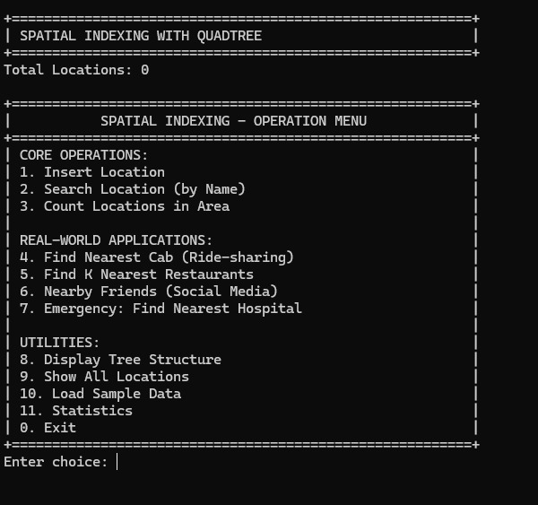
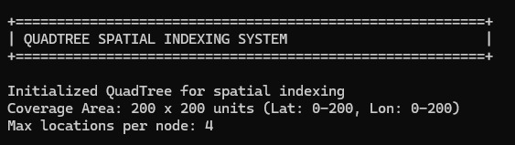
Code Output:

Slide 21
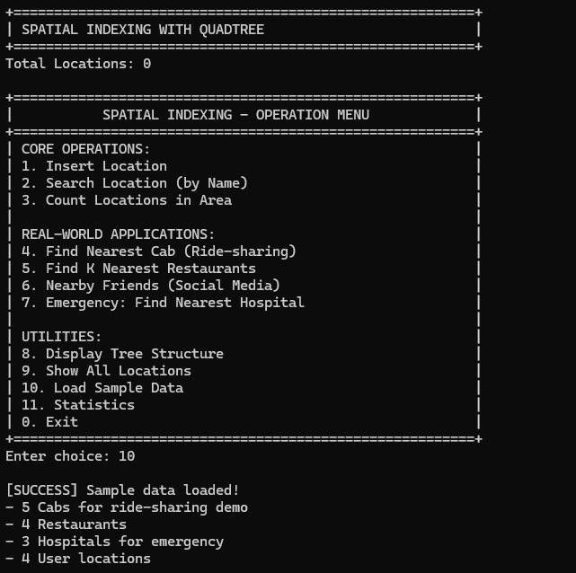
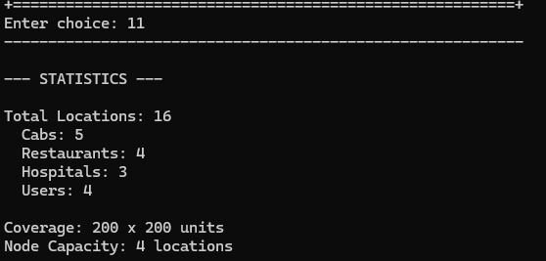
Code Output:

Slide 22
Conclusion:
QuadTree is an efficient spatial data structure
Suitable for real-world applications
Project demonstrates:
Insertion
Searching
Range queries
Nearest neighbor search
GUI enhances usability and visualization

Slide 23
Thank You

